Slide 1


Cohort Analysis
Online Retail Project

Slide 2
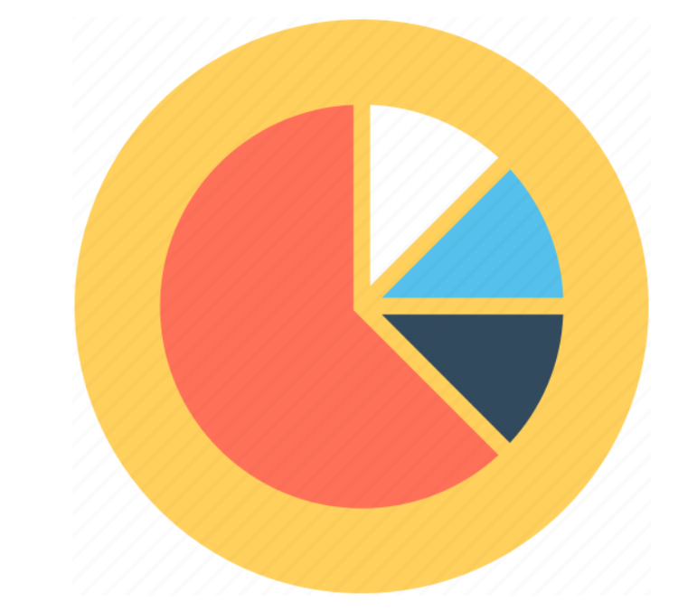


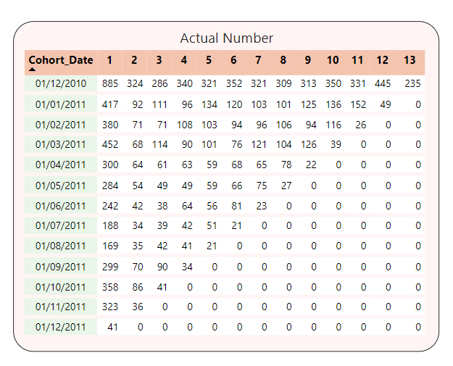
COHORT TABLE
Based on the data from the Cohort Table analyzed, we could see:
The new and retention customers by month from 12/2010 to 12/2011 had highly decreased in joining to use services. Customers didn’t come back regularly after using services. Only the first group of customers joining in 12/2010 came back with a quantity of over 200 customers.
885 new customers were acquired in the first month, which is 20 times more than the number of new customers in the final month. The highest number of new customers was in December 2010 (885), while the lowest was in December 2011 (41).
With the volume of returning customers, we can divide into 3 big groups by counting the volume of returning customers:
The first group (12/2010) always had a volume of returning customers greater than 200, something that the following group customers did not have.
The second group ( from 01/2011 to 03/2011) had several months greater than 100 customers.
The third group is the rest with quantities smaller than 100 customers.

Slide 3


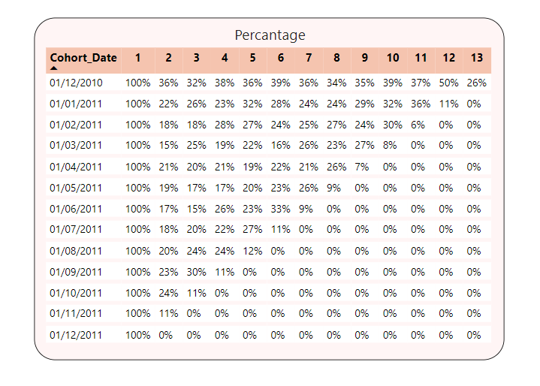
COHORT TABLE
According to the analysis of the percentage cohort table, it is evident that the number of customers who returned was mostly under 50% each month. Moreover, the percentage of return purchase rate (RPR) was always under 40% after the customers' initial purchase. The highest rate was observed in the first month, with 36% after the customers used the service for the first time. This suggests that the customers did not have a good experience with the service.
In each customer group, there was a notable increase in the percentage of RPR (returning paying customers) every month, except for the last month, where it decreased significantly and only showed minor fluctuations, ranging from 6% to 11% on average. This trend was observed in all groups except for the first customer group, which displayed a 26% RPR.
The cohort analysis revealed that the company's product or service did not meet customer expectations, resulting in low customer retention rates.

Slide 4
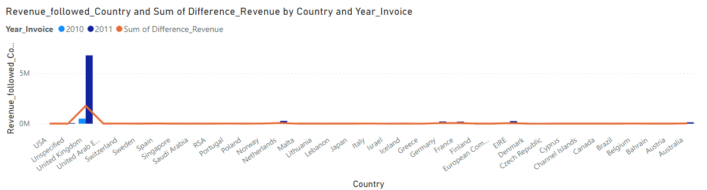
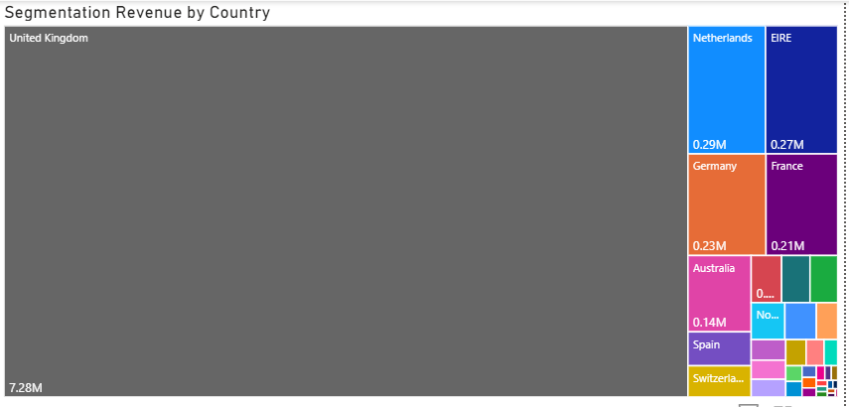
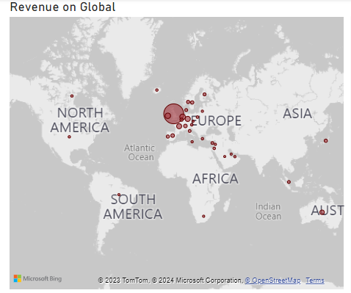
OTHER CHARTS DISPLAY THE REVENUE
Revenue followed Year and Country
Segmentation Revenue by Country
Consumer on Global
Over the course of a year, the revenue in the United Kingdom demonstrated an upward trend. In contrast, other countries experienced only slight or no increases in revenue. This remarkable growth highlights the importance of the United Kingdom market, which has been a primary focus for the company over the past several years. Moving forward, if we continue to make progress in this market and its surrounding countries, we can expect further expansion in the future.
In general, the United Kingdom generated the highest revenue and outperformed all other countries by a significant margin. The sales figures of all other countries combined did not match the sales figures of the United Kingdom alone, which exceeded 1 million. In contrast, other countries had sales figures lower than 0.3 million. The visual chart clearly illustrates a significant disparity in the sales figures, with the majority of sales being generated in the United Kingdom.
The map chart depicts the revenue of various countries across the globe, with a particular emphasis on Europe. The biggest circle on the map corresponds to the United Kingdom, suggesting that the Company should give more priority to this market. However, in the long run, the Company should also consider expanding its presence in Asia and America.
(See the detailed data in the PowerBI file)

Slide 5
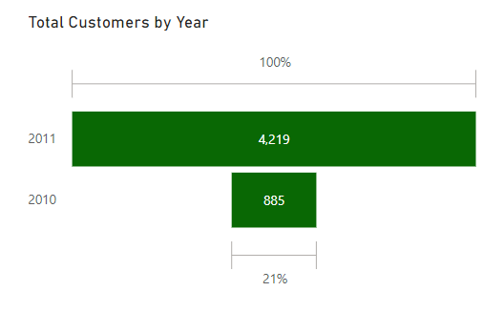
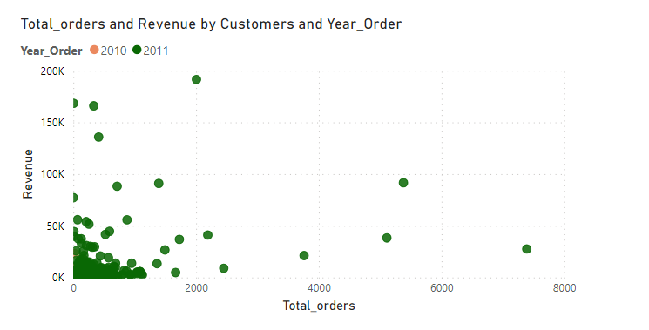
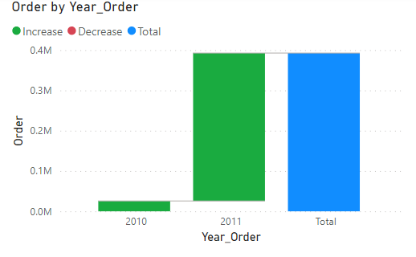
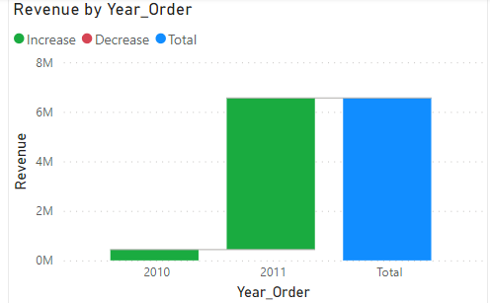
THE CHARACTERISTICS OF CUSTOMERS
After one year, the number of customers increased almost fivefold from 885 to 4219.
The scatter chart reveals that the customers tend to spend less and make irregular orders. This highlights the need to rethink the existing strategies and come up with innovative approaches to boost customer engagement and retention.
With an increase in customers, the number of orders rose to 367,004 from 25,665. This indicates a positive trend for the company to attract more customers.
Over a year, the revenue has shown a steady upward trend, increasing from 437,345 to 6,122,944. This positive growth is a result of effective strategies and efforts, but cohort analysis showed the revenue could be decreased throughout the customer experience.

Slide 6
PROBLEM & SOLUTION
Based on the analysis, we could define a big problem of the company that the customers hadn’t had a great experience with service. Specifically, the retention rate was not high, it was only almost under 40%. Additionally, the market only concentrated on Europan which brought mostly revenue for the company. So, we can define some points:
Problem 1: There are two groups we can divide into - December 2010 and after. The first group had initial customers and a higher retention rate compared to the second group.
Suggestion: Define why the difference in the number of customers decreased rapidly, including the strategic acquisition of new customers being lower than the first month.
Problem 2: The retention rate was always so low with an index under 40%.
Suggestion:
- Optimize User Experience and continuously optimize products or services based on user feedback and behavior data by collecting data from customers after using the service.
- Reward Loyalty: Implement loyalty programs, discounts, or rewards for long-term users to incentivize them to continue using your product or service.

